Slide 1

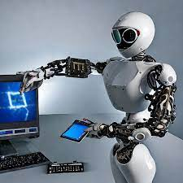
2024 Data Science & AI Symposium
Roadmap to Data Science & Artificial Intelligence
By
Joseph Luper Tsenum,
AI Consultant for Drug Discovery in North Carolina, U.S.; PhD Student in the U.S; Executive Director @ NELIREF
June 28, 2024

Slide 2
Outline
Introduction
Why Artificial Intelligence?
Definition of AI/ML
Roadmap to AI/ML
Hard/Soft Skills in the Era of AI
Machine Learning Algorithms
Conclusion
Q/A

Slide 3
Why Artificial Intelligence as a Christian?
Psalms 2
1 "Why do the nations rage, And the people plot a vain thing? 2 The kings of the earth set themselves, And the rulers take counsel together, Against the Lord and against His Anointed, saying, 3 “Let us break Their bonds in pieces And cast away Their cords from us.”
Jer 1:9
"Then the Lord put forth His hand and touched my mouth, and the Lord said to me: "Behold, I have put My words in your mouth. ¹⁰ See, I have this day set you over the nations and over the kingdoms, To root out and to pull down, To destroy and to throw down, To build and to plant."
51:20-23
“You are My battle-ax and weapons of war: For with you I will break the nation in pieces; With you I will destroy kingdoms; 21 With you I will break in pieces the horse and its rider; With you I will break in pieces the chariot and its rider; 22 With you also I will break in pieces man and woman; With you I will break in pieces old and young; With you I will break in pieces the young man and the maiden; 23 With you also I will break in pieces the shepherd and his flock; With you I will break in pieces the farmer and his yoke of oxen; And with you I will break in pieces governors and rulers."

Slide 4
Interpretable ML/AI Models
Gen 41
^{9"} Then the chief butler spoke to Pharaoh, saying: “I remember my faults this day. ¹⁰ When Pharaoh was angry with his servants, and put me in custody in the house of the captain of the guard, both me and the chief baker, ¹¹ we each had a dream in one night, he and I. Each of us dreamed according to the interpretation of his own dream. ¹² Now there was a young Hebrew man with us there, a servant of the captain of the guard. And we told him, and he interpreted our dreams for us; to each man he interpreted according to his own dream. ¹³ And it came to pass, just as he interpreted for us, so it happened. He restored me to my office, and he hanged him.”
²⁴ And the thin heads devoured the seven good heads. So I told this to the magicians, but there was no one who could explain it to me.”
²⁵ Then Joseph said to Pharaoh, “The dreams of Pharaoh are one; God has shown Pharaoh what He is about to do: ²⁶ The seven good cows are seven years, and the seven good ^{[b]}heads are seven years; the dreams are one. ²⁷ And the seven thin and ugly cows which came up after them are seven years, and the seven empty heads blighted by the east wind are seven years of famine. ²⁸ This is the thing which I have spoken to Pharaoh. God has shown Pharaoh what He is about to do. ²⁹ Indeed seven years of great plenty will come throughout all the land of Egypt; ³⁰ but after them seven years of famine will arise, and all the plenty will be forgotten in the land of Egypt; and the famine will deplete the land.
³¹ So the plenty will not be known in the land because of the famine following, for it will be very severe. ³² And the dream was repeated to Pharaoh twice because the thing is established by God, and God will shortly bring it to pass.
³³ “Now therefore, let Pharaoh select a discerning and wise man, and set him over the land of Egypt. ³⁴ Let Pharaoh do this, and let him appoint ^{[c]}officers over the land, to collect one-fifth of the produce of the land of Egypt in the seven plentiful years. ³⁵ And let them gather all the food of those good years that are coming, and store up grain under the ^{[d]}authority of Pharaoh, and let them keep food in the cities. ³⁶ Then that food shall be as a ^{[e]}reserve for the land for the seven years of famine which shall be in the land of Egypt, that the land may not ^{[f]}perish during the famine.”
³⁷ So the advice was good in the eyes of Pharaoh and in the eyes of all his servants. ³⁸ And Pharaoh said to his servants, “Can we find such a one as this, a man in whom is the Spirit of God?”
³⁹ Then Pharaoh said to Joseph, “Inasmuch as God has shown you all this, there is no one as discerning and wise as you. ⁴⁰ You shall be ^{[g]}over my house, and all my people shall be ruled according to your word; only in regard to the throne will I be greater than you.” ⁴¹ And Pharaoh said to Joseph, “See, I have set you over all the land of Egypt.”

Slide 5
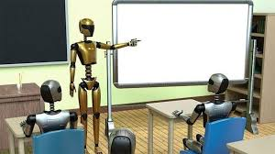
What is Artificial Intelligence?
"AI is a machine’s ability to perform the cognitive functions we associate with human minds, such as perceiving, reasoning, learning, interacting with an environment, problem solving, and even exercising creativity." ~ McKinsey.
You interact with AI daily without realizing it such as Siri voice assistants, customer service chatbots, Generative AI such as ChatGPT, gaming, predictive models for risk/protective factors in healthcare, forecasting models in businesses, mobile banking, fraud detection, customer engagement, social media such as Facebook, etc.
Driverless cars, scheduling of elevators, self-navigating vaccum cleaners are some of the applications of Reinforcement learning.

Slide 6
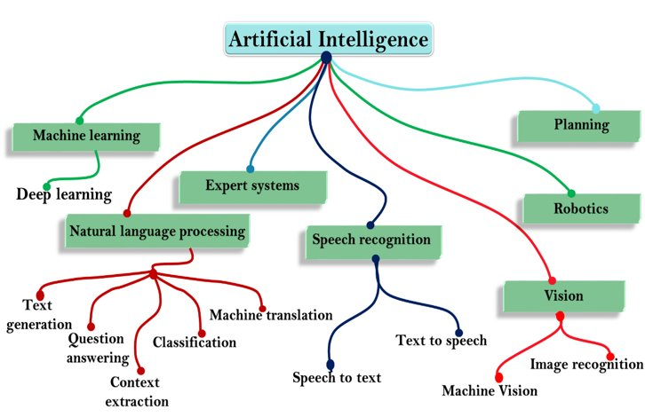
Branches of Artificial Intelligence
https://tekrajawasthi15.medium.com/the-complete-roadmap-to-be-a-data-scientist-9a07721b88fd

Slide 7
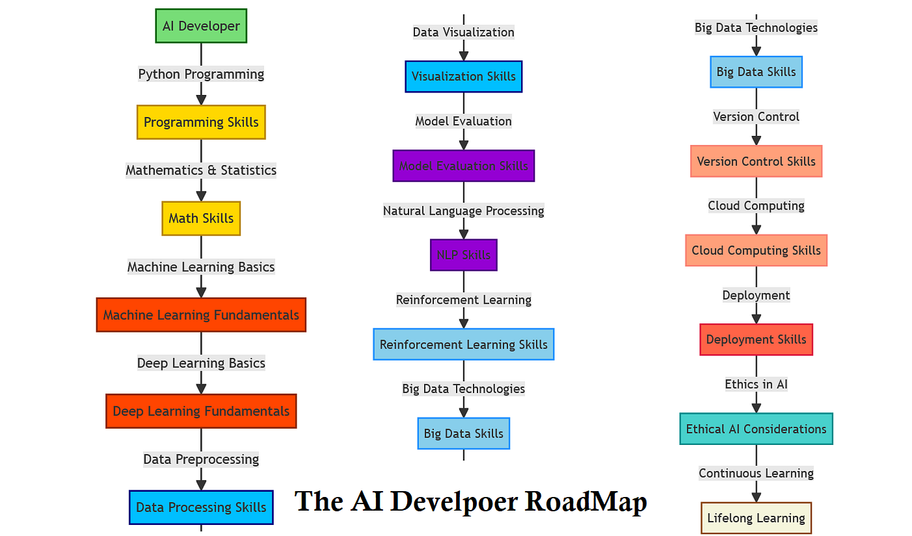
Roadmap to Artificial Intelligence and Machine Learning
AI/ML study resources compiled by New Life Research Foundation Training Department: Check our platforms for details.
Apply for Financial Aid on Coursera and take free online courses such as Maths of Machine Learning by Deeplearning.AI (Andrew Ng). Check our platforms for details.

Slide 8
Hard Skills Needed in the Era of AI/ML
Hard Skills
Bash scripting, ability to work in a Linux/Unix environment, programming skills (Python, R, SQL, Java, C & C++, MATLAB, Perl, Ruby, etc), Machine learning (supervised & unsupervised learning), generative/automated models, interpretable AI such as LIME, SHAP, Anchors; PyTorch, Keras-Tensorflow and Sklearn usage, database management, statistical analysis, mobile development, network security, PowerBI, Tableau, ability to use LaTex editor, Adobe software suite such as Adobe Illustrator, etc.
Possess hard skills that will be helpful in our pioneering work and flagship projects.
Artificial intelligence and machine learning are implemented using Python programming language (and others such as R).

Slide 9
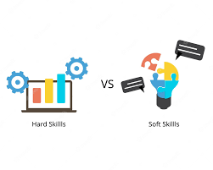
Soft Skills Needed in the Era of AI/ML
Soft Skills
Hard skills are not sufficient for research in a tech Century, every researcher is therefore expected to possess soft skills.
Integrity, emotional intelligence (empathy), dependability, effective communication including good presentation skills, open-mindedness, teamwork, creativity, problem-solving, critical thinking, adaptability, organization, willingness to learn, leadership, time management, work ethic, conflict management).

Slide 10
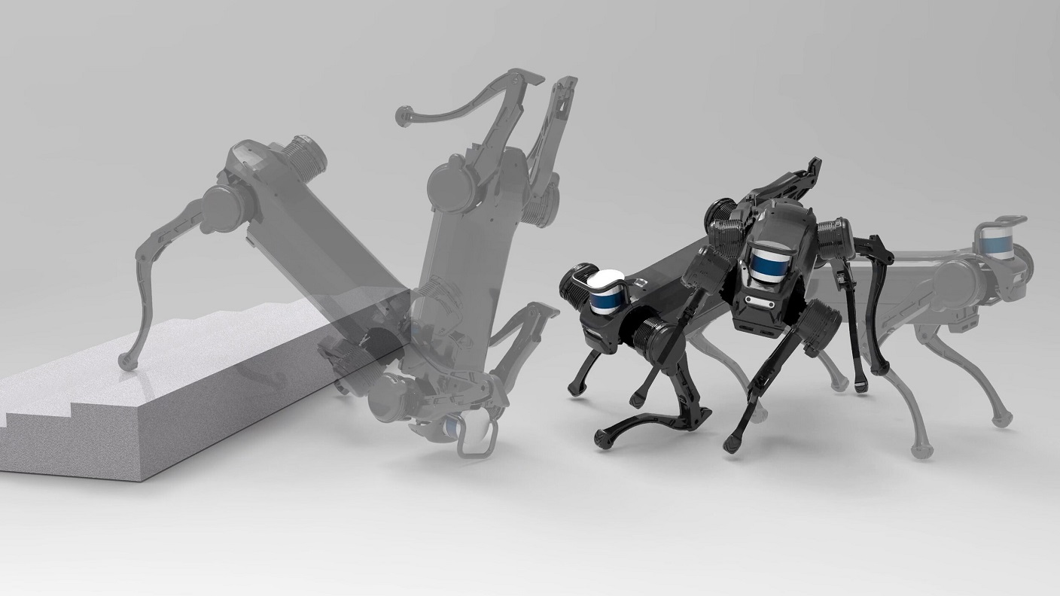
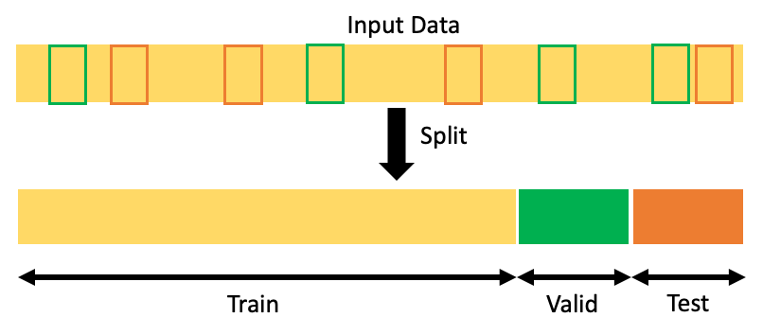
What is Machine Learning?
Machine Learning is the science of teaching machines how to learn by themselves. It is a type of artificial intelligence based on algorithms that are trained on data.
In 1970s, machine learning was applied in medical-imaging analysis and high-resolution weather forecasting.
Today, ML can learn from data and detect patterns thereby making predictions to help in decision and policy making.
Deep learning is a type of machine learning that can process large amounts of data such as images, bulk biological data, etc.
DL requires less human intervention, and can produce more accurate results (unsupervised learning) than traditional or classical machine learning methods (supervised learning). New patterns are learned.
Source: https://towardsdatascience.com/how-to-split-data-into-three-sets-train-validation-and-test-and-why-e50d22d3e54c

Slide 11
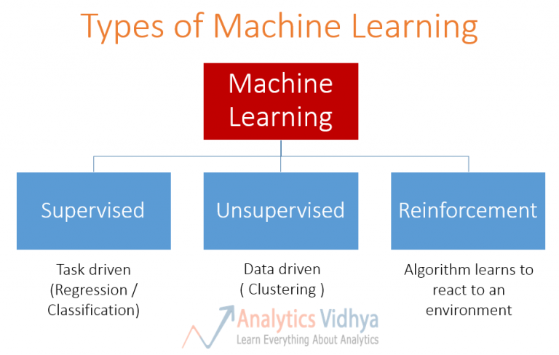

Slide 12
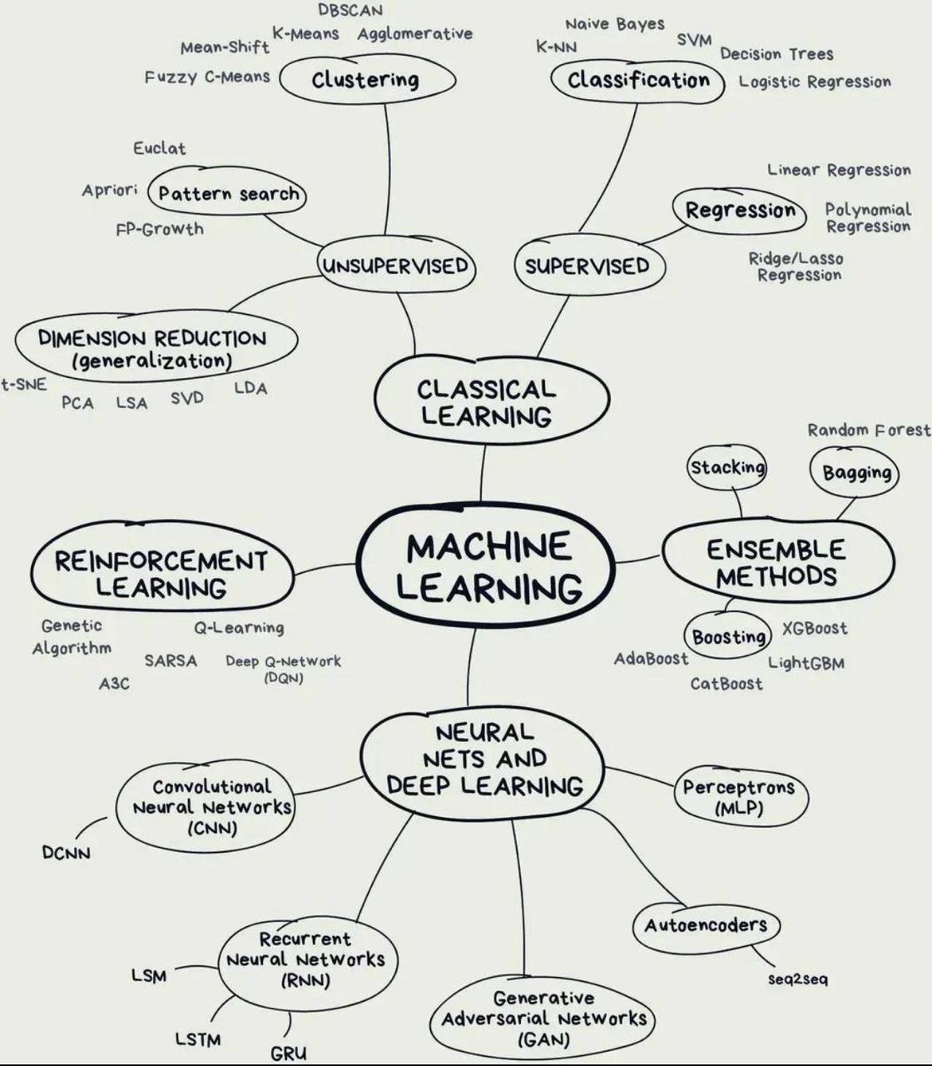
Source: Atul Kumar

Slide 13
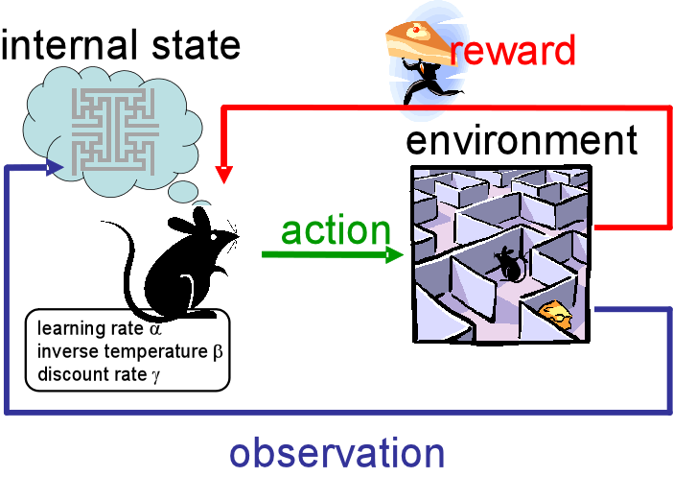
Reinforced Learning
The pet is the artificial agent
The good behavior is the resultant action
The treatment is the reward function
Source: UTCS RL Reading Group

Slide 14
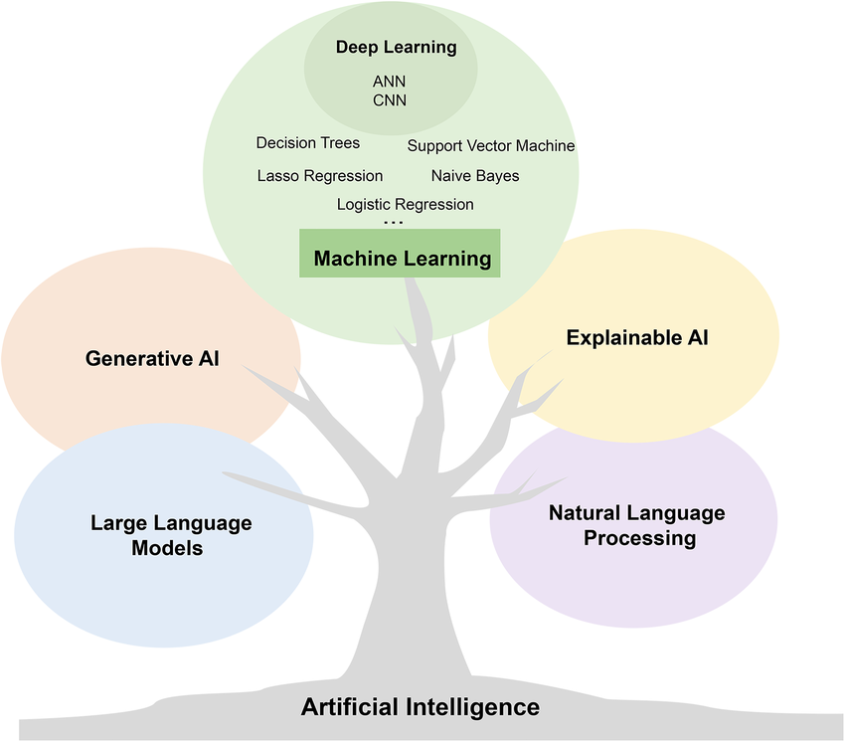
AI Revolution

Slide 15
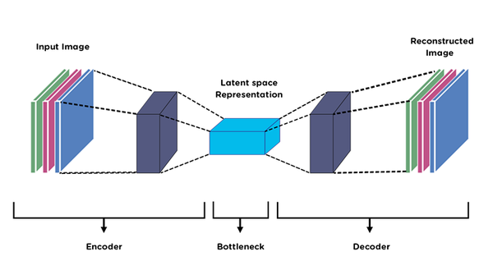
Autoencoders
Source: Premanand S (Analytics Vidhya)

Slide 16
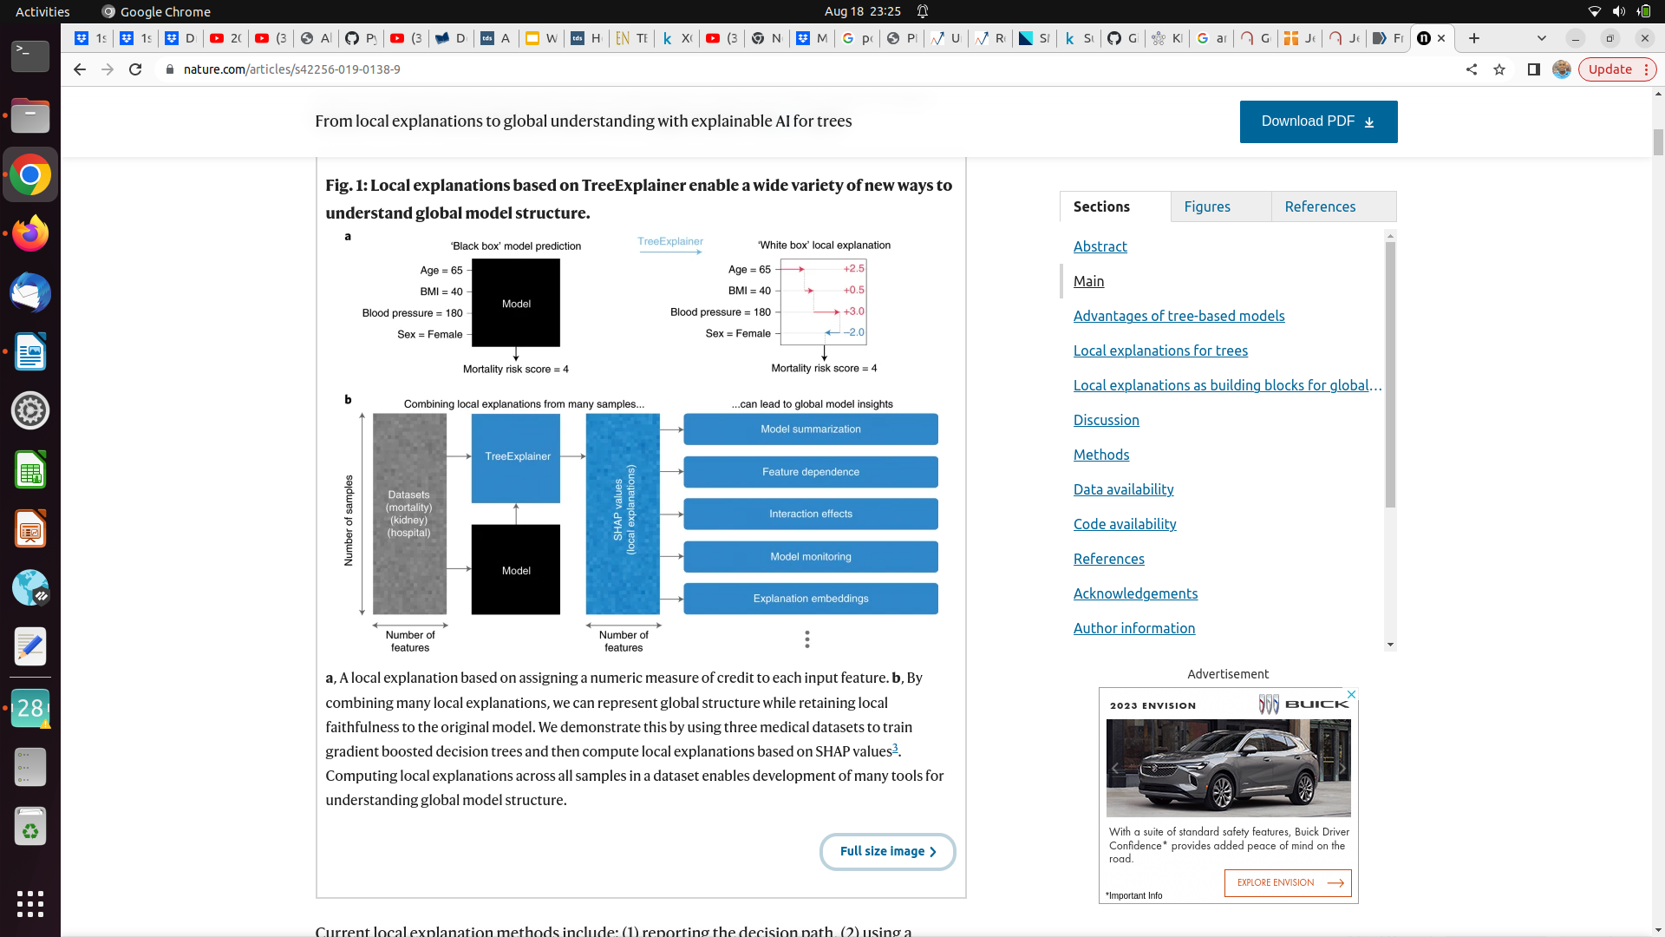
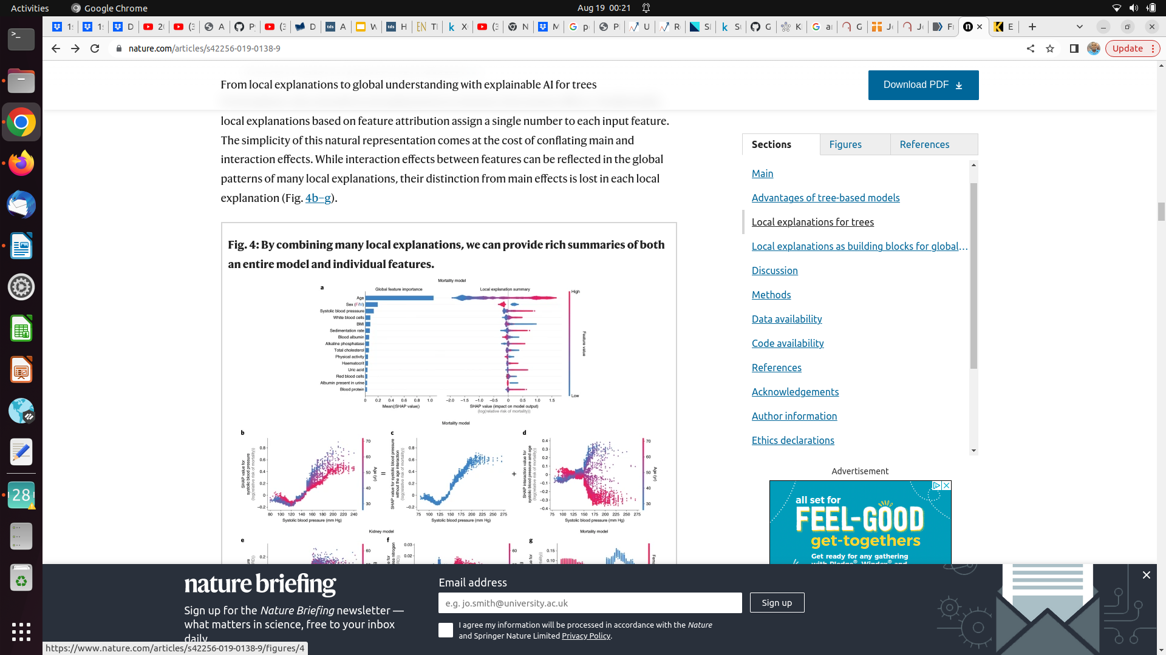
Increasing demand for Interpretable Black Box Models
Lundberg et al, 2020

Slide 17
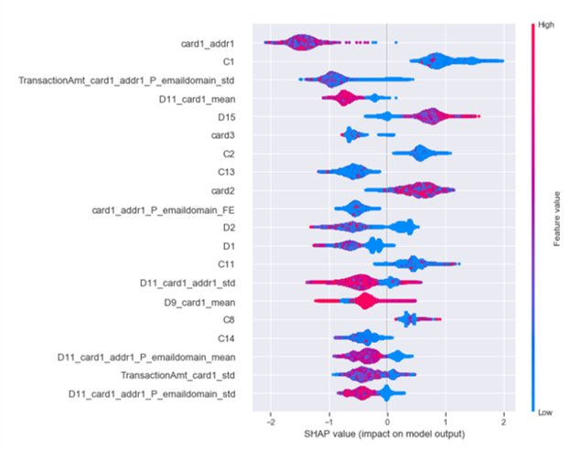
Interpretable Ensemble and Deep Learning Using LIME and SHAP
Courtesy: Shilpi Bhattacharyya

Slide 18
Announcement NELIREF Annual Conference comes up in August 2024, visit our website for more details at https://neliref.org/ Q/A

Slide 19
References
Lundberg, S.M., Erion, G., Chen, H. et al. From local explanations to global understanding with explainable AI for trees. Nat Mach Intell 2, 56–67 (2020). https://doi.org/10.1038/s42256-019-0138-9
Explaining Black Box Models: Ensemble and Deep Learning Using LIME and SHAP. Shilpi Bhattacharyya, Data Scientist at IBM. https://www.kdnuggets.com/2020/01/explaining-black-box-models-ensemble-deep-learning-lime-shap.html
What is AI?. April 24, 2023 | Article by McKinsey. https://www.mckinsey.com/featured-insights/mckinsey-explainers/what-is-ai#/
6 Major Branches of Artificial Intelligence (AI). Neelam Tyagi. Apr 23, 2020, Updated on: Jan 23, 2021. https://www.analyticssteps.com/blogs/6-major-branches-artificial-intelligence-ai
2023 State of AI in 14 Charts. Apr 3, 2023| Shana Lynch. https://hai.stanford.edu/news/2023-state-ai-14-charts
Unleashing the Power of Autoencoders: Applications and Use Cases. Premanand S — Published On May 26, 2023 and Last Modified On June 13th, 2023. https://www.analyticsvidhya.com/blog/2023/05/unleashing-the-power-of-autoencoders-applications-and-use-cases/

Slide 20


